Slide 1


Slide 2

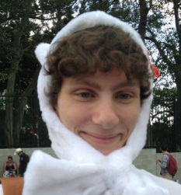



Our Team
Students:
Zane Keeley
Carlisle Miller
Rowan Lysaught
Angus Holliday
Client:
Activate Entertainment

Slide 3



Client Requirements
Build an engaging gamification of the concept of empathy
Assist in providing teachers with a new tool to help young minds learn empathy
The game will align with the organisations focus
Provide further job opportunities
Contribute to Activates Entertainments goal of being leaders in innovate educational tools
Contribute to Activate Entertainments competitiveness in the marketplace
Incorporate on a platform that can be delivered nationwide across Australia

Slide 4


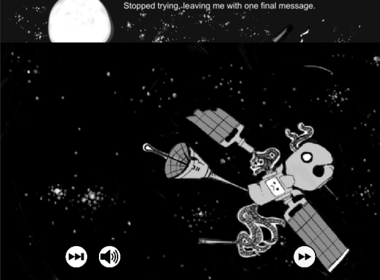
Key Elements
Teaching Empathetic Skills
Teamwork
Seeing from someone else’s perspective
Identifying that everyone has different strengths and weaknesses
Being prepared and willing to help others when they need it
Gameplay
Incorporate and teach empathetic actions
Allow the player to have fun while learning
Replayability to help build habits regarding empathy
Narrative
Building the tone of the game to encourage empathetic actions/feelings
Engage the player within the game
Encourage positive discussion among players

Slide 5
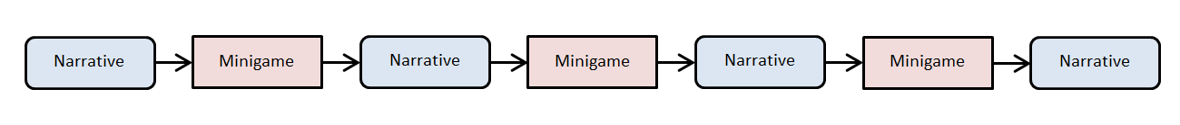
Empathotron
Description:
A game which incorporates a story and a narrative
Playable on a tablet
Intertwines a narrative and a gaming experience into one
Encourage empathetic feelings before the start of each mini-game
Objectives:
Continuously keeps the game engaging
(having a narrative scene before each minigame)
Can be extended in the future, to provide further job opportunities and increase Activate Entertainments competitiveness
Highly accessible to teachers, to be used as a tool for helping teach empathy

Slide 6
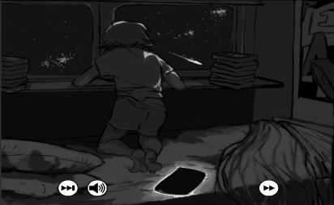
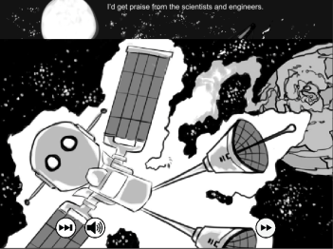
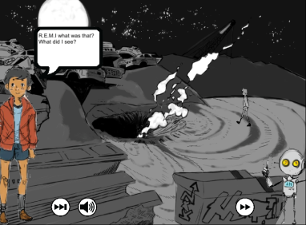
Narrative Storyline
Description:
A boy in a room sees something fall from sky
The boy finds robot who has suffered damage from an impact
The boy decides to help retrieve the robots eyes, legs and arms
Along the way, the boy talks to the robot and builds a relationship
Objectives:
An interesting story to engage the user
Builds empathetic feelings to help support teaching empathy
Builds empathetic skills such as helping other people
Builds empathetic relationships

Slide 7
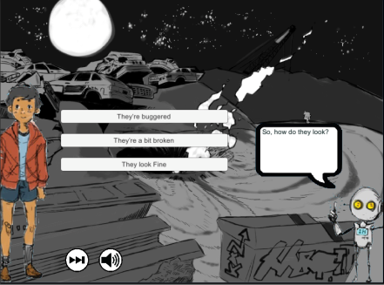
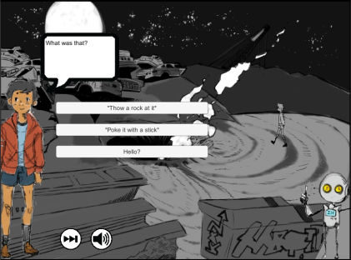
Narrative Questions
Description:
There are a series of questions asked between games during the narrative scenes.
Each answer has weighting
A = 1
B = 2
C = 3
The running total is stored based on the answers to determine a conclusion
Objectives:
Encourages decisions based the current setting leaning towards empathy
Helps keep the player engaged with game (the player has to answer questions to progress)
Can be used to monitor the results of players empathy long term (measure progress)
Notes:
Show the process a player follows when answering the questions, and highlight the type of questions being asked (encourages empathetic decision making)

Slide 8
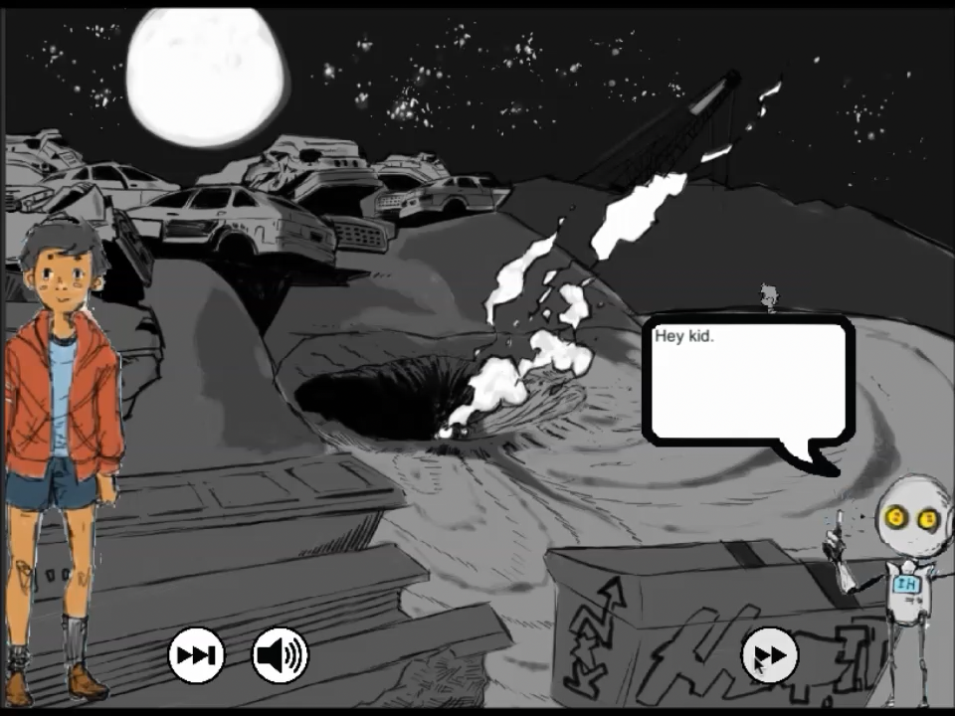
Narrative Demonstration

Slide 9
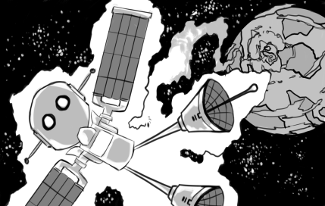
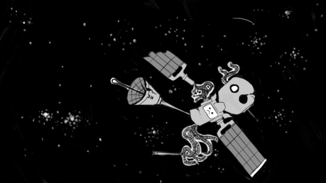
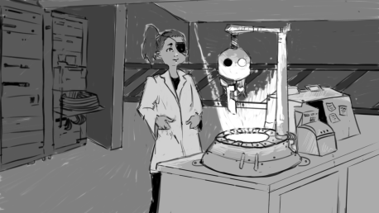
Alternate Conclusions
Description:
Different conclusions were offered to provide variance within the game
The 3 different conclusions currently offered are:
REMI goes home and reveals nothing to the boy (if the user is unempathetic with REMI)
REMI stays on planet Earth, but not with the boy (if the user is moderately empathetic)
REMI stays on planet Earth with the boy and reveal everything (if the user shows high levels of empathy)
Objectives:
Keeps the player curious as to the outcome (including previous players of the game) – which encourages interest/engagement within the game
Encourages replayability to further the level of teaching regarding empathy
Encourages discussion between the players – to help extend the nationwide reach of the game

Slide 10
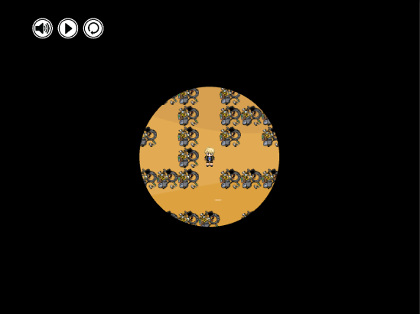
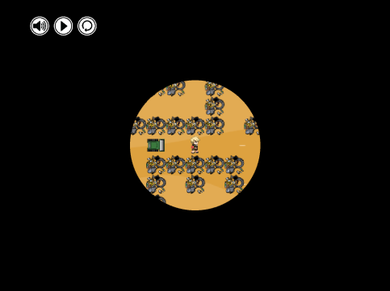
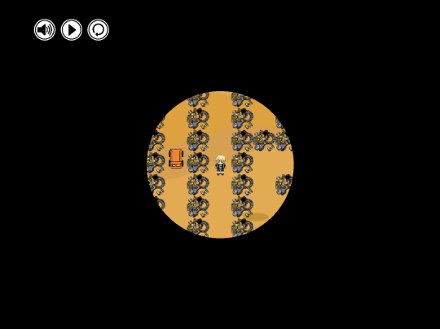
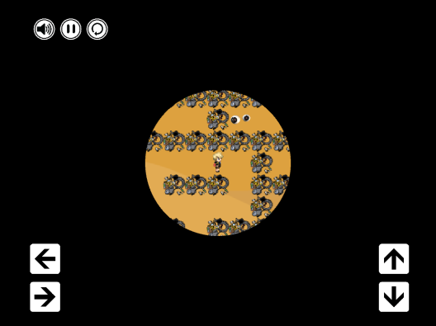
Blind Maze Minigame
Description:
Players navigate through a maze with limited vision
Players have to avoid monsters while trying to reach the objective
Keeps the player concerned and alert throughout the game
Requires strategic thinking regarding how to avoid monsters/reach an objective when seen on an opposite side of a wall
Objectives:
Place the player in the shoes of someone with a disability (limited vision)
Encourage the player to experience cognitive empathy towards people with any form of disability
Resonate with a disability due to the disability being so relevant in the game
Replayability
Able to be expanded in the future (more mazes, features and scenarios can be included)

Slide 11
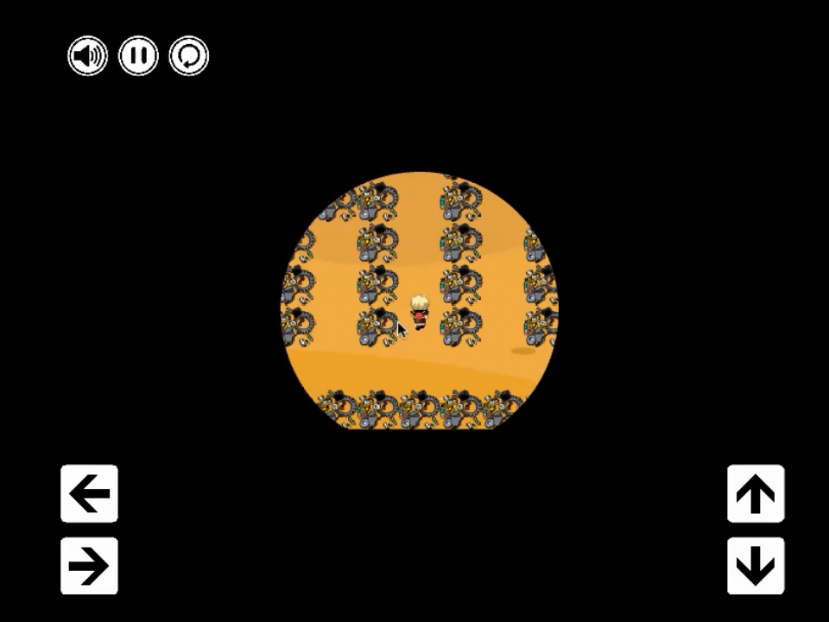
Blind Maze Demonstration

Slide 12
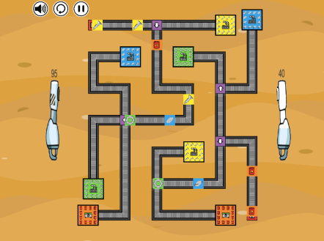
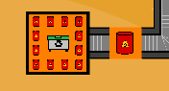
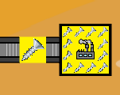
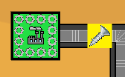
Resource Inflow Minigame
Description:
Send resources to the correct factory to help build REMI’s arms
Divert dangerous resources to a disposal site to avoid damaging the reconstruction or REMI’s arms
Game cannot be lost – it can only be won
Multi tasking 2 points of resources
Score bars to highlight reconstruction progress
Objectives:
Replayability
Can be Expanded to provide more features and job opportunities in the future
Encourages empathy through helping someone at a disadvantage
Sends a message that you can never ‘lose’ trying to help someone – the player is diverting danger only to avoid damaging progress
Strategic thinking to keep the player engaged
Gives instant feedback to the player

Slide 13
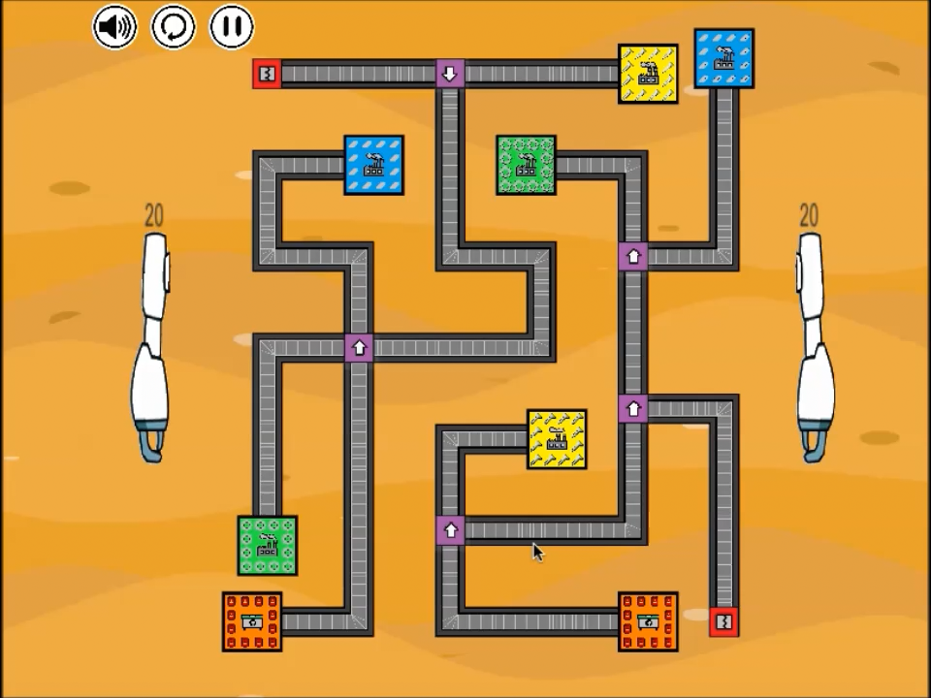
Resource Inflow Demonstration

Slide 14
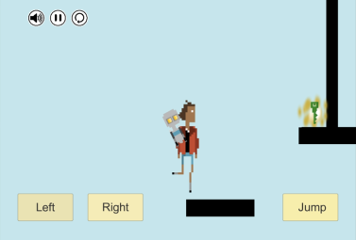
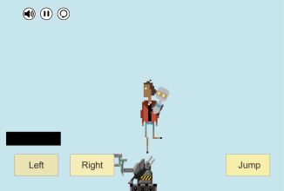
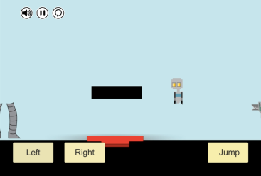
Platformer Minigame
Description:
REMI and the main character start by working together as a team to collect a key
Player is constantly avoiding dangerous monsters and jumping over obstacles
REMI gets detached from the main character mid-game, and goes to retrieve its legs back by itself
Objectives:
Teamwork to encourage co operation and empathetic relationships
Highlighting that everyone has different strengths and weaknesses
Can be expanded with more features and maps in the future

Slide 15
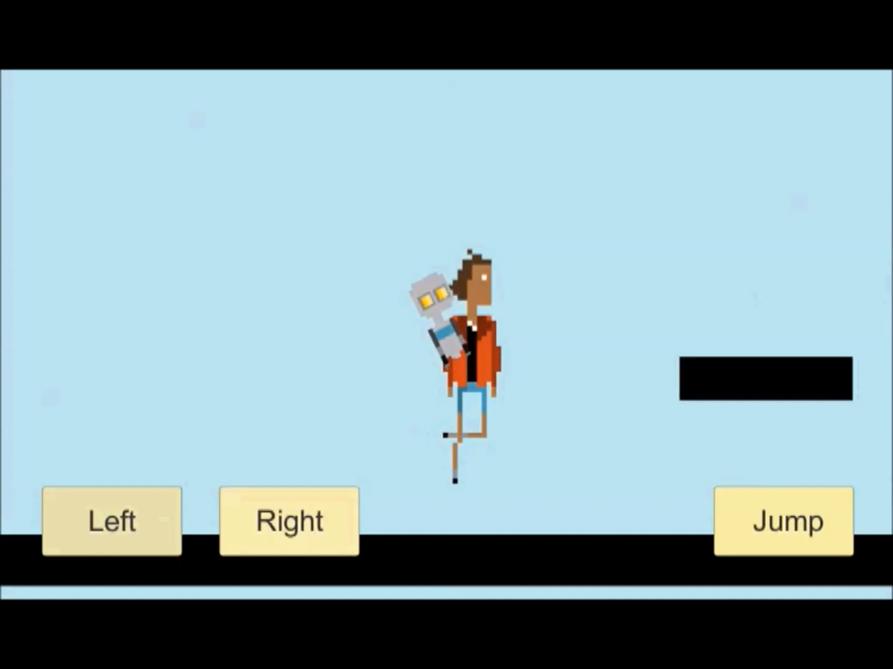
Platformer Demonstration

Slide 16
Testing and Feedback
Testing:
Regular client feedback regarding the contents of the game
Target audience testing
Use case testing
Purpose:
Ensuring the Buttons/Events relevant to each scenario within the game work as intended
Refining our game to continuously improve its quality
Ensuring our game is impactful with our target audience

Slide 17
Thank You
We hope you enjoyed the Empatatron
Now Lets Encourage Teaching Empathy Worldwide!

Slide 18
Questions
Anything You Would You Like to Ask?

